Slide 1
NodeJs Session
Sashidharan Kanagaraj

Slide 2
HTTP Modules
Set of rules for data being transferred on the web application.
Stands for Hypertext Transfer Protocol. It's a format defining data being transferred via TCP/IP
HTTP module use to create a server/client transaction.
HTTP interface is careful to never buffer entire requests or responses, so the user can able to stream data.

Slide 3
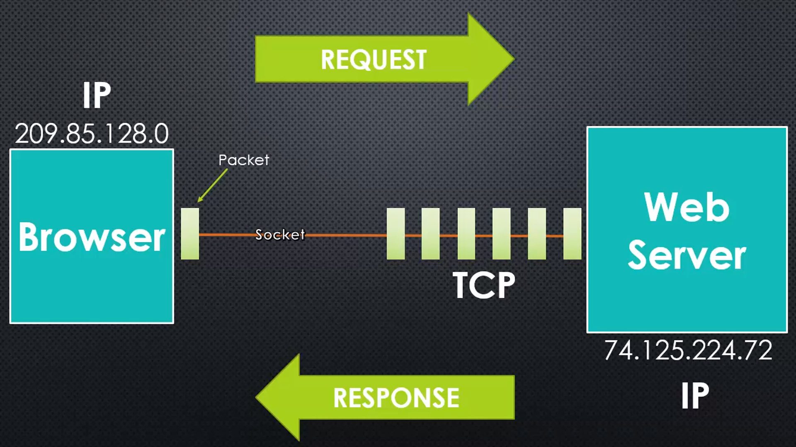
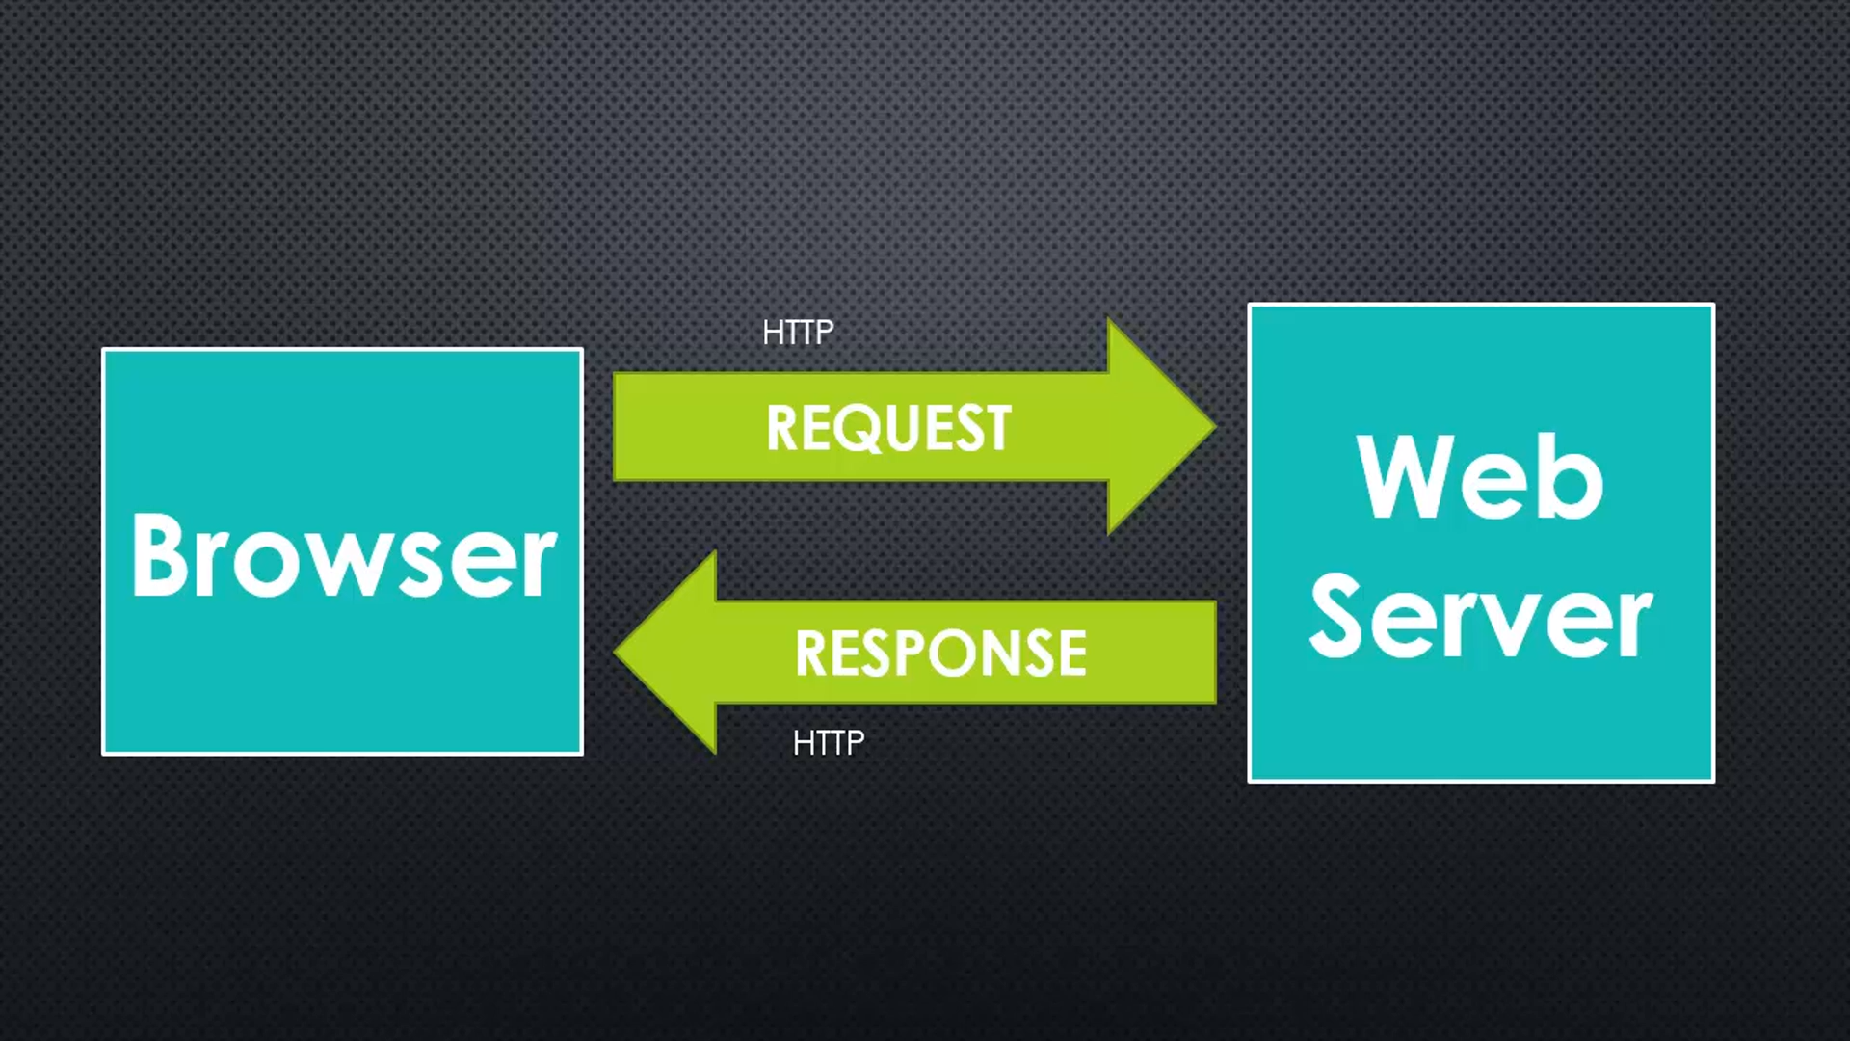
HTTP Modules

Slide 4
HTTP Request
Handling the HTTP Request, first thing want to look in the Method and URL, to apply the appropriate action.
Methods – represents the normal HTTP method to send the information to server
URL - means everything after and including the forward slash.
Headers & Body – represents the content type and body of the content.

Slide 5
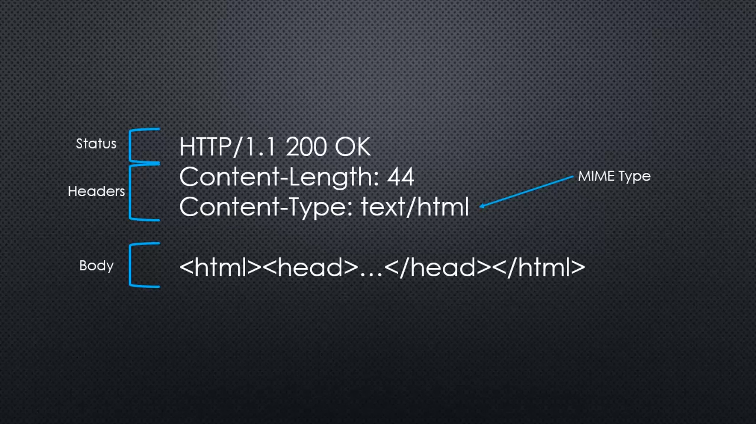
HTTP Response
Status – Contain the response status with code.
Headers – Sets the response content types
MIME - Standard for specifying the type of data being sent. Stand for Multipurpose Internet Mail Extension.
For Eg. application/json, text/html, image/jpeg
Body – Displays the content to be showed.

Slide 6
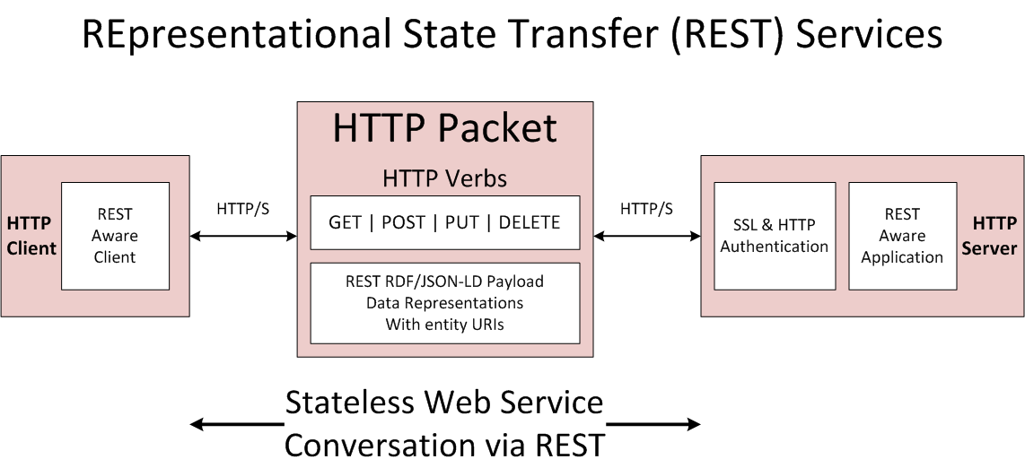
RESTful
REST stands for REpresentational State Transfer. REST is web standards-based architecture and uses HTTP Protocol.
A REST Server simply provides access to resources.
REST client accesses and modifies the resources..
REST uses various representation to represent a resource like text, JSON, XML but JSON is the most popular one

Slide 7
REST HTTP Methods
Following four HTTP methods are commonly used in REST based architecture.
GET − This is used to provide a read only access to a resource.
PUT − This is used to create a new resource.
DELETE − This is used to remove a resource.
POST − This is used to update a existing resource or create a new resource

Slide 8
REST Methods
Sr. No. | HTTP Method | URI | Operation | Operation Type
1 | GET | /UserService/users | Get list of users | Read Only
2 | GET | /UserService/user/1 | Get User with Id 1 | Read Only
3 | POST | /UserService/users/ | Insert User | Write
4 | PUT | /UserService/user/2 | Update User with Id 2 | N/A
5 | DELETE | /UserService/user/1 | Delete User with Id 1 | No Response, Only Status Code

Slide 9
REST Architectural Constraints
Uniform Interface - REST defines a set of well-defined operations that can be executed on a resource
Client-server - Client application and Server application MUST be able to evolve separately without any dependency on each other
Stateless - Communication between client and server is stateless, will treat every request as new. No session, no history.
Cacheable - Stateless client-server communication can increase server load since some information may have to be transferred several times so requests that only retrieve data should be cache-able
Layered System - client cannot ordinarily tell whether it is connected directly to the end server, or to an intermediary along the way
Code on demand (optional) - Most of the time, you will be sending the static representations of resources in the form of XML or JSON. But when you need to, you are free to return executable code

Slide 10
Package Management System
Its kind of a manifest for your project. It can do a lot of things.
It's a central repository of configuration for tools, for example. It's also where npm and yarn store the names and versions for all the installed packages.
Managed and maintain with a package management system.
Software that automate installing and updating packages and deals with version on dependencies.
To create the package.json type in CLI as npm init

Slide 11
Package Properties
name sets the application/package name
version indicates the current version
description is a brief description of the app/package
main set the entry point for the application
private if set to true prevents the app/package to be accidentally published on npm
scripts defines a set of node scripts you can run
dependencies sets a list of npm packages installed as dependencies
devDependencies sets a list of npm packages installed as development dependencies
engines sets which versions of Node.js this package/app works on
browserslist is used to tell which browsers (and their versions) you want to support
All those properties are used by either npm or other tools that we can use.

Slide 12
Package Versions
Using semver (semantic versioning) all versions have 3 digits, the first being the major release, the second the minor release and the third is the patch release
~: if you write ~0.13.0, you want to only update patch releases: 0.13.1 is ok, but 0.14.0 is not.
^: if you write ^0.13.0, you want to update patch and minor releases: 0.13.1, 0.14.0 and so on.
*: if you write *, that means you accept all updates, including major version upgrades.
>: you accept any version higher than the one you specify
>=: you accept any version equal to or higher than the one you specify
<=: you accept any version equal or lower to the one you specify
<: you accept any version lower to the one you specify
There are other rules, too:
no symbol: you accept only that specific version you specify
latest: you want to use the latest version available

Slide 13
Queries

